Slide 1
PBI (RETAIL STORE) DASHBOARD

Slide 2

"Begining with an introduction explaining the purpose and data sources of the dashboard, followed by a detailed review of its components including cards for key metrics like customer count and revenue, and a variety of visualizations such as pie, bar, line, and tree charts detailing revenue, sales, and units across different dimensions. Conclude with a summary of major insights, strategic recommendations derived from the data,
agenda

Slide 3
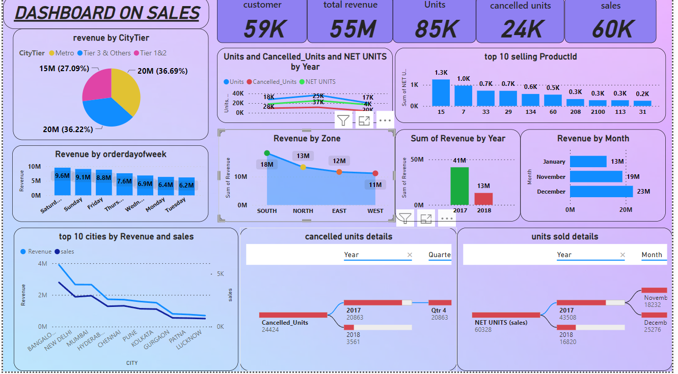

Slide 4
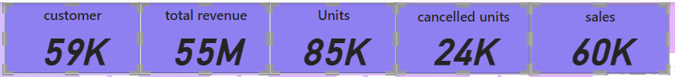
1.Customer Base and Sales Metrics:
The Card displaying the count of customers, total revenue, units sold, cancelled units, and net sales provides a quick snapshot of overall business health. Tracking the growth or decline in customer numbers can indicate market reach and effectiveness of marketing strategies.
Monitoring total revenue alongside units sold and cancelled units helps in understanding the revenue efficiency and product acceptance in the market.

Slide 5
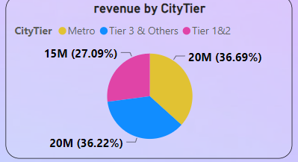
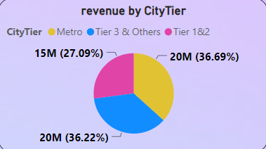
2.Revenue Distribution by City Tier:
The Pie Chart illustrating revenue by city tier can offer insights into which geographic segments are generating the most revenue. This helps in tailoring marketing and sales strategies to capitalize on high-performing areas or to improve underperforming tiers.

Slide 6
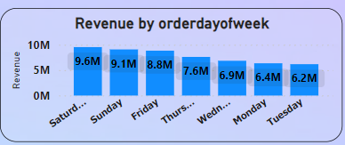
3.Bar Chart (Revenue by Order Week)
Identifies weekly revenue trends, helping in understanding weekly fluctuations in sales. This can inform staffing and inventory decisions, and highlight effective promotional periods.

Slide 7
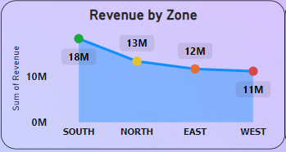
4. Line Chart (Revenue by Zone)
Shows geographic distribution of revenue. It may help pinpoint strong and weak zones, guiding regional marketing efforts and possibly suggesting areas for expansion or improvement.
Metric | Measurement | Target | Actual
Audience attendance | # of attendees | 150 | 120
Engagement duration | Minutes | 60 | 75
Q&A interaction | # of questions | 10 | 15
Positive feedback | Percentage (%) | 90
Rate of information retention | Percentage (%) | 80

Slide 8
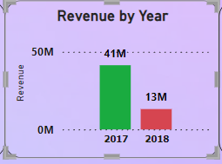
5. Bar Chart (Revenue by Year)
Consistent rehearsal
Strengthen your familiarity
Refine delivery style
Pacing, tone, and emphasis
Timing and transitions
Aim for seamless, professional delivery
Practice audience
Enlist colleagues to listen & provide feedback
Provides a clear view of year-over-year growth or decline. This long-term perspective is crucial for strategic planning and assessing the impact of major business decisions or market conditions.

Slide 9
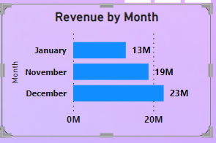
6. Stacked Bar Chart (Revenue by Month)
Impact factor | Measurement | Target | Achieved
Audience interaction | Percentage (%) | 85 | 88
Knowledge retention | Percentage (%) | 75 | 80
Post-presentation surveys | Average rating | 4.2 | 4.5
Referral rate | Percentage (%) | 10 | 12
Collaboration opportunities | # of opportunities | 8 | 10
Breaks down monthly revenue performance, allowing for the assessment of seasonal trends or the impact of specific events (like holidays or promotions) on sales.

Slide 10
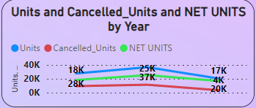
7.Line Chart (Units, Cancelled Units, Net Units by Year)
This comparison is crucial for understanding the relationship between total units sold, units cancelled, and the actual net units sold. Trends here can lead to actions targeted at reducing cancellations and increasing customer satisfaction.

Slide 11
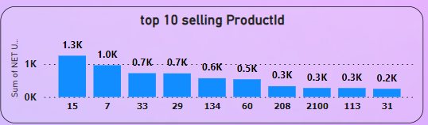
8. Bar Chart (Top 10 Selling Products for Net Units by Product ID)
Focuses on your best-selling products, which can inform inventory management, production planning, and marketing focus. Also useful for identifying star products or potential areas needing improvement or discontinuation.

Slide 12
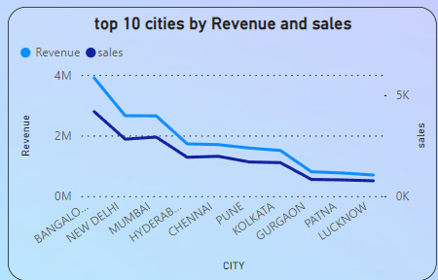
9. Line Chart (Top 10 Cities Based on Revenue by Sale)
Identifies key cities driving your business's revenue. This insight can help refine localized marketing campaigns and possibly influence distribution and logistics strategies.

Slide 13
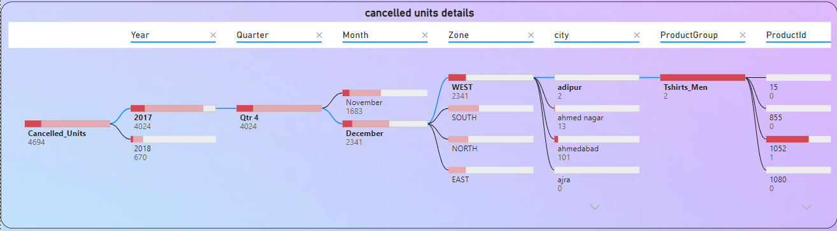
10.Tree Chart (Cancelled Units Based on Year, Month, Zone, Cities, etc.)
Provides a detailed hierarchical view of where and when cancellations are occurring most frequently, which can help in pinpointing operational issues or customer dissatisfaction sources.

Slide 14
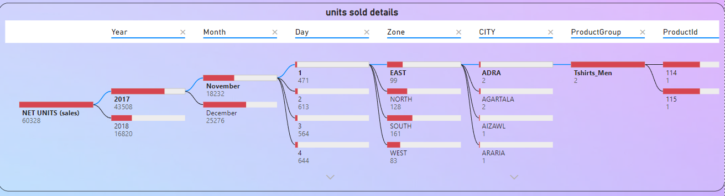
11.Tree Chart (Sold Units Based on Year, Month, Zone, Cities, etc.)
Similar to the cancelled units chart, but focuses on where and when units are sold. This helps in understanding successful areas and periods, and in planning for future sales strategies to maximize performance.

Slide 15
summary
By leveraging the insights from these dashboard elements, you can make informed decisions to improve various aspects of your business operations, from marketing and sales to product development and customer service. Each component not only offers a standalone insight but can also be interconnected to provide a holistic view of the business's performance and opportunities.

Slide 16
Thank you
Santosh sg
6361315309
santoshgowdru15@gmail.com
www.linkedin.com/in/santosh-gowdru-68722b306

